Slide 1
Day 5
Exceptions & File handling

Slide 2
Exception
Undesirable event detectable during program execution
A way to handle the runtime error
If without handling,
Program crashes
Falls into unknown state
Occur infrequently
Makes programs robust and fault-tolerant
An exception handler is a section of program code that is designed to execute when a particular exception occurs
Resolve the exception

Slide 3
try/catch Block
Statements that may generate an exception are placed in a try block
The try block also contains statements that should not be executed if an exception occurs
The try block is followed by one or more catch blocks

Slide 4
try/catch Block (continued)
The catch block:
Specifies the type of exception it can catch
Contains an exception handler
If the heading of a catch block contains ... (ellipses) in place of parameters
Catch block can catch exceptions of all types

Slide 5
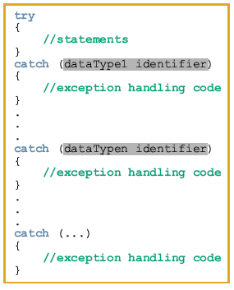
General syntax of the try/catch block:

Slide 6
try/catch Block (continued)
If no exception is thrown in a try block
All catch blocks for that try block are ignored
Execution resumes after the last catch block
If an exception is thrown in a try block
Remaining statements in that try block are ignored

Slide 7
Execution of try-catch
A
statement throws
an exception
No
statements throw
an exception
Exception
Handler
Control moves directly to exception handler
Statements to deal with exception are executed
Statement
following entire try-catch
statement

Slide 8
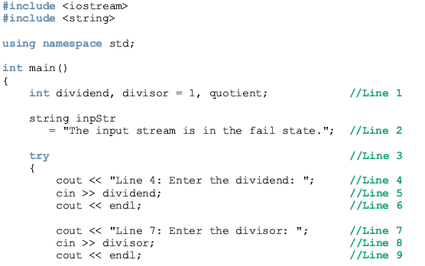
Throwing an Exception to be Caught by the Calling Code
void Func3()
{
try
{
Func4();
}
catch ( ErrType )
{
}
}
Function
call
void Func4()
{
if ( error )
throw ErrType();
}
Normal
return
Return from
thrown exception

Slide 9
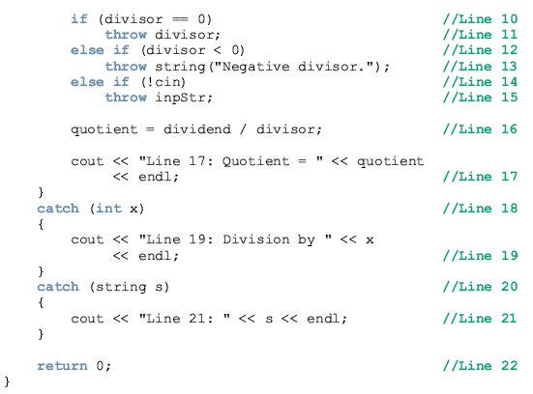

Slide 10
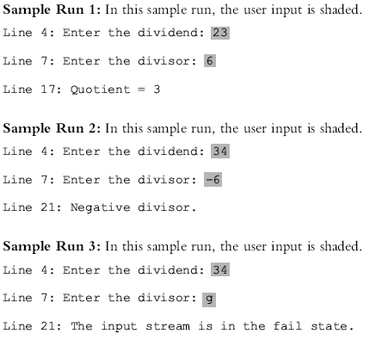

Slide 11
example

